Slide 1
NMCS Conditioning & Weight Training
Summer 2014

Slide 2
Flexibility/Mobility

Slide 3
Cervical/Thoracic Extension

Slide 4
Rotation

Slide 5
Hamstrings

Slide 6
Nutrition/Diet
Eat
Meat and Fresh Vegetables
Nuts and Seeds
Some Fruit and Dairy
Little or NO Starch (Starch is simple carbohydrates. Breads, Cereals, Pasta, Potatoes, and Rice)
And NO SUGAR.

Slide 7
Keep These Tips in Mind
Try to avoid foods that have a list of ingredients. Real food spoils and does not come in cans or boxes. A steak or chicken breast does not have a list of ingredients, neither do broccoli or other vegetables.
Don’t fear the fat. For example, real butter is much better for you than oleo or margarine. Avoid “low fat” or “fat free” food substitutes.
Avoid alcohol, soda, and sweetened juices.
You should do most of your shopping around the perimeter of the store. The fresh, nutritious foods are not found in the aisles.
Allow yourself 1 or 2 “Cheat” meals each week. In your cheat meals you can eat or drink whatever you like. Don’t let “1 or 2” become 4, or 5, or more.

Slide 8
Expect some carbohydrate “withdrawal” symptoms. Many of us have developed a carbohydrate addiction, and as you wean yourself away from simple, highly processed carbohydrates you may experience symptoms that many people compare to quitting smoking. These symptoms will only last 2 or 3 days.

Slide 9
Beach Muscles vs. Athleticism
Many athletes and coaches (especially young men) focus on the muscles we see in the mirror. Pecs, abs, biceps, and quads. While there is benefit in exercising every muscle group, we often neglect many of the muscles we can’t see.
Most athletic endeavors are largely dependent on strong, explosive hip extension. Pushing, jumping, running are all dependent on hip extension.
Explosive hip extension benefits from squats, but there are several even more effective exercises.
To improve athleticism, we need to focus on the muscles people see when we’re walking away from them.

Slide 10
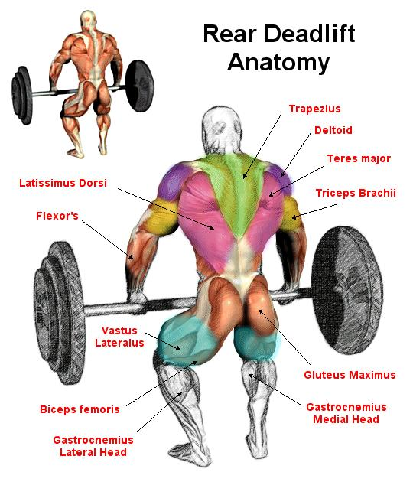
This is why we use Deadlifts, Cleans, Snatch, Pull ups, Rows, and Shrugs.

Slide 11
Another Key Point to Athleticism -
FREE WEIGHTS RULE!
Weight machines are designed to mimic free weight exercises and body weight exercises. Machines, in general, are a poor choice for developing well rounded fitness. They eliminate planes of movement, eliminate the need for stabilization, and allow people to sit or lie down during exercise.
If you have a weight machine in your basement, and you enjoy using it, then I wouldn’t expect you to get rid of it and buy a bunch of free weights, but if given a choice go with free weights.

Slide 12
Here are the primary lifts we will be focusing on.

Slide 13
Deadlift The greatest way to strengthen your back, hips, and Hamstrings. These are the key to explosive hip extension. It is imperative to learn and strengthen the dead lift before trying the more explosive lifts; the snatch and the clean & jerk.

Slide 14
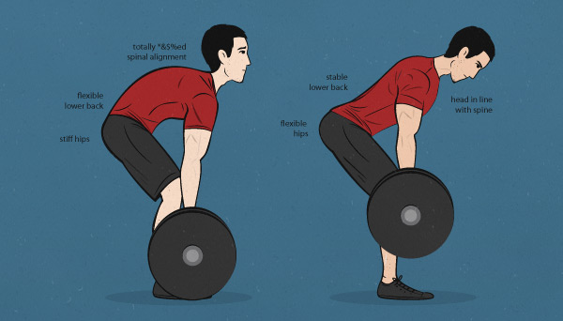
Bad and Good Form
Wrong

Slide 15
Power Snatch Using explosive hip and back extension to generate enough momentum to get a weight up over head that is too heavy to lift strictly.

Slide 16
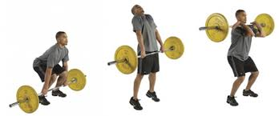
Power Clean Using explosive hip and back extension to generate enough momentum to get a weight up to shoulder level that is too heavy to lift strictly.

Slide 17
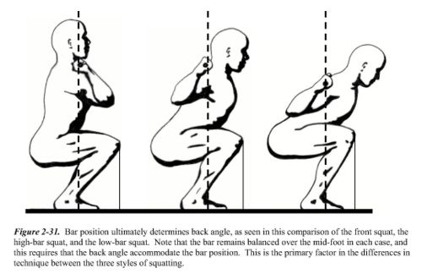
The Squat and it’s variations. Crucial for developing full body strength, balance, and midline stabilization.

Slide 18
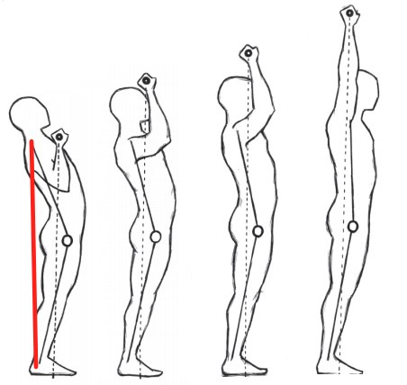
The Press and it’s variations Crucial for developing upper body strength and full body balance and midline stabilization.

Slide 19
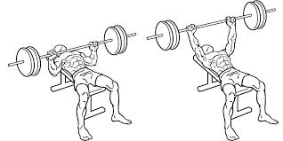
The Bench Press is a variation of the Press. We will use this as an accessory exercise for upper body strength, but it has very little practical sport application.

Slide 20
Calisthenics/Gymnastics
We will teach the athletes a variety of body weight movements as well.
Push ups, Pull ups, Dips, Squats, Lunges, and many variations of those.

Slide 21
In Conclusion
Eat meat and vegetables, nuts and seeds, some fruit, little starch and no sugar.
Limit food intake to amounts that will support exercise but not body fat.
Master the basics of calisthenics & gymnastics:
Push ups, pull ups, dips, rope climbing, sit ups, press to handstands, somersaults, and holds.
Practice and train all variations of the major lifts:
Deadlifts, squats, presses, clean & jerk, and snatch.
Run, bike, swim, row - hard and fast.
Five or six days per week mix these elements in as many combinations and patterns as creativity will allow. Routine is the enemy.
Focus on your weaknesses until they become a strength.
Keep workouts short and intense.

